Slide 1
UNIT II
Activities, Fragments & Intents

Slide 2
Understanding Activities
An Android application can have zero or more activities. Typically, applications have one or more activities. An activity is a single screen in android.
The main purpose of an activity is to interact with the user. From the moment an activity appears on the screen to the moment it is hidden, it goes through a number of stages. These stages are known as an activity’s life cycle.
The Activity base class defines a series of events that govern the life cycle of an activity.

Slide 3
The Activity Lifecycle
As a user navigates through, out of, and back to your app, the Activity instances in your app transition through different states in their lifecycle. The Activity class provides a number of callbacks that let the activity know when a state changes or that the system is creating, stopping, or resuming an activity or destroying the process the activity resides in.
To navigate transitions between stages of the activity lifecycle, the Activity class provides a core set of six callbacks: onCreate(), onStart(), onResume(), onPause(), onStop(), and onDestroy(). The system invokes each of these callbacks as the activity enters a new state.

Slide 4
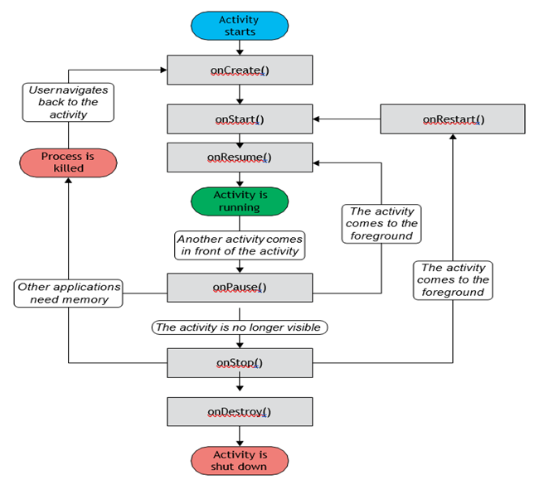
Understanding Activities
Understanding Activities

Slide 5
1. onCreate()
You must implement this callback, which fires when the system first creates the activity. On activity creation, the activity enters the Created state. In the onCreate() method, perform basic application startup logic that happens only once for the entire life of the activity.
2. onStart()
When the activity enters the Started state, the system invokes onStart(). This call makes the activity visible to the user as the app prepares for the activity to enter the foreground and become interactive. For example, this method is where the code that maintains the UI is initialized.
3. onResume()
When the activity enters the Resumed state, it comes to the foreground, and the system invokes the onResume() callback. This is the state in which the app interacts with the user. The app stays in this state until something happens to take focus away from the app, such as the device receiving a phone call, the user navigating to another activity, or the device screen turning off.

Slide 6
4. onPause()
The system calls this method as the first indication that the user is leaving your activity, though it does not always mean the activity is being destroyed. It indicates that the activity is no longer in the foreground, but it is still visible if the user is in multi-window mode.
There are several reasons why an activity might enter this state:
An event that interrupts app execution, as described in the section about the onResume() callback, pauses the current activity. This is the most common case.
In multi-window mode, only one app has focus at any time, and the system pauses all the other apps.
The opening of a new, semi-transparent activity, such as a dialog, pauses the activity it covers. As long as the activity is partially visible but not in focus, it remains paused.

Slide 7
5. onStop()
When your activity is no longer visible to the user, it enters the Stopped state, and the system invokes the onStop() callback. This can occur when a newly launched activity covers the entire screen. The system also calls onStop() when the activity finishes running and is about to be terminated.
6. onDestroy()
onDestroy() is called before the activity is destroyed. The system invokes this callback for one of two reasons:
The activity is finishing, due to the user completely dismissing the activity or due to finish() being called on the activity.
The system is temporarily destroying the activity due to a configuration change, such as device rotation or entering multi-window mode.

Slide 8
Applying Styles and Themes to an Activity
Styles and themes on Android let you separate the details of your app design from the UI structure and behavior, similar to stylesheets in web design.
A style is a collection of attributes that specify the appearance for a single view. A style can specify attributes such as font color, font size, background color, and much more.
A theme is a collection of attributes that's applied to an entire app, activity, or view hierarchy—not just an individual view. When you apply a theme, every view in the app or activity applies each of the theme's attributes that it supports.
Styles and themes are declared in a style resource file in res/values/, usually named styles.xml.
The Material theme has a much more modern and clean look to it. There are two versions of the Material theme available to Android developers: Material Light and Material Dark.

Slide 9
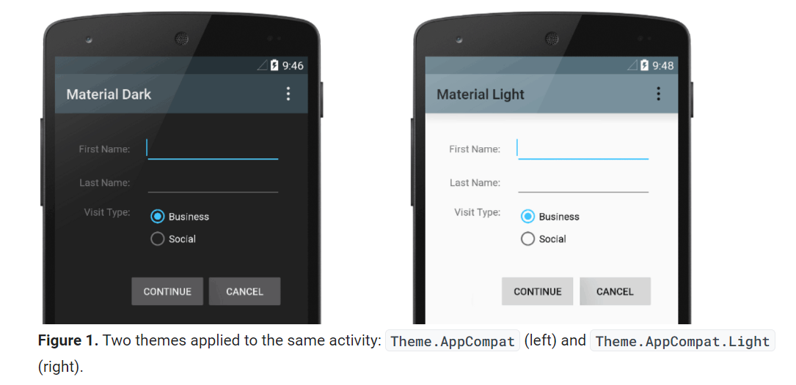
Applying Styles and Themes to an Activity

Slide 10
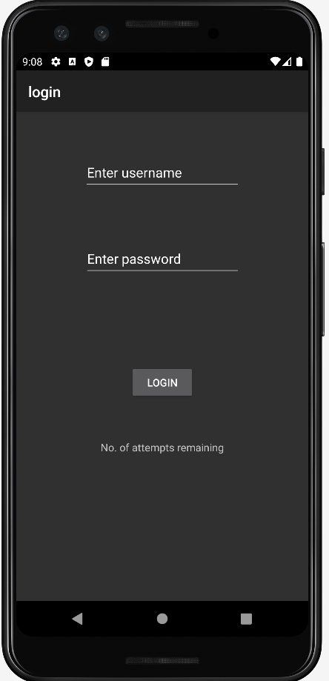
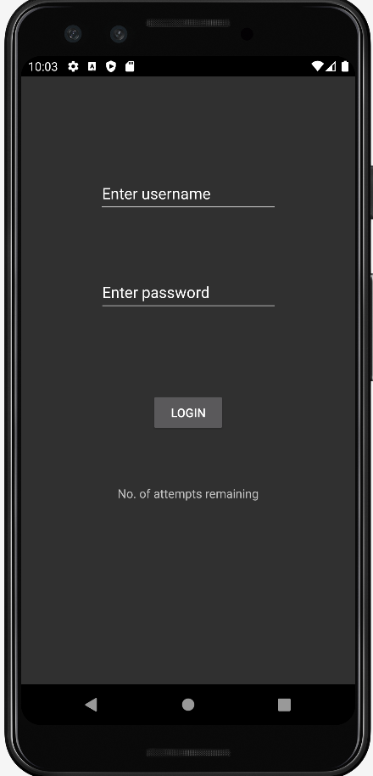
Hiding the Activity Title
Android Title Bar or ActionBar or Toolbar is the header of any screen in an App. We usually keep fixed title names for every Activity. Sometimes, it is necessary to remove the bar from the activity.
Without ActionBar

Slide 11
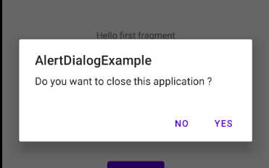
Displaying a Dialog Window
A dialog is a small window that prompts the user to make a decision or enter additional information. A dialog does not fill the screen and is normally used for modal events that require users to take an action before they can proceed.
A modal dialog forces the user to interact with the dialog before going back to the application or activity the user was interacting with in the first place. Basically a modal dialog is used to get essential user input before continuing the application.

Slide 12
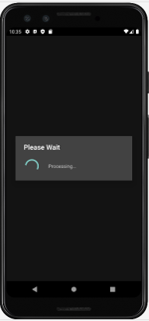
Displaying a Progress Dialog
One common UI feature in an Android device is the “Please wait” dialog that you typically see when an application is performing a long-running task. For example, the application might be logging in to a server before the user is allowed to use it, or it might be doing a calculation before displaying the result to the user. In such cases, it is helpful to display a dialog, known as a progress dialog, so that the user is kept in the loop.
Android provides a ProgressDialog class you can call when you want to display a running meter to the user.

Slide 13
Linking Activities - Using Intents
An Android application can contain zero or more activities. When your application has more than one activity, you often need to navigate from one to another. In Android, you navigate between activities through what is known as an intent.
Android Intent is the message that is passed between components such as activities, content providers, broadcast receivers, services etc. It is generally used with startActivity() method to invoke activity, broadcast receivers etc.
Android intents are mainly used to:
Start the service
Launch an activity
Display a web page
Display a list of contacts
Broadcast a message or Dial a phone call etc.

Slide 14
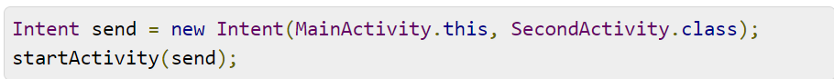
The startActivity() method invokes another activity but does not return a result to the current activity.

Slide 15
Pending Intent
A PendingIntent object helps you to perform an action on your application’s behalf, often later, regardless of whether your application is running or not.
A pending intent is a wrapper around regular intent that is designed to be used by another application.
It gives that other application the ability to perform the included action as it was your application with all the permissions your application has been granted.

Slide 16
Fragments
A fragment is a part of applications user interface that is bound to an activity. Fragments have their lifecycle and layouts or UI components.
Android Fragment is the part of activity, it is also known as sub-activity. There can be more than one fragment in an activity. Fragments represent multiple screen inside one activity.
A Fragment is a combination of an XML layout file and a java class much like an Activity. Fragments encapsulate views and logic so that it is easier to reuse within activities. Fragments are always embedded in an activity.
Fragments also have their logic and can thus, accept and handle different events. Fragments are beneficial since they allow code to be divided into smaller and more manageable chunks.

Slide 17
Each fragment has its own life cycle methods that is affected by activity life cycle because fragments are embedded in activity.
Fragments can exist only inside an activity as its lifecycle is dependent on the lifecycle of host activity.
For example, if the host activity is paused, then all the methods and operations of the fragment related to that activity will stop functioning, thus fragment is also termed as sub-activity. Fragments can be added, removed, or replaced dynamically i.e., while activity is running.

Slide 18
Need Of Fragments In Android:
Before the introduction of Fragment’s we can only show a single Activity on the screen at one given point of time so we were not able to divide the screen and control different parts separately. With the help of Fragment’s we can divide the screens in different parts and controls different parts separately.
By using Fragments we can comprise multiple Fragments in a single Activity. Fragments have their own events, layouts and complete life cycle. It provide flexibility and also removed the limitation of single Activity on the screen at a time.

Slide 19
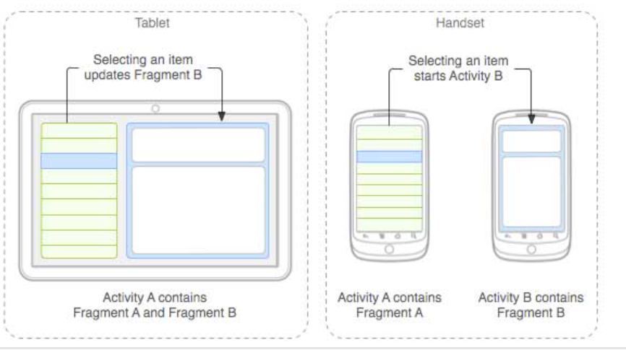
Following is a typical example of how two UI modules defined by fragments can be combined into one activity for a tablet design, but separated for a handset design.
The application can embed two fragments in Activity A, when running on a tablet-sized device. However, on a handset-sized screen, there's not enough room for both fragments, so Activity A includes only the fragment for the list of articles, and when the user selects an article, it starts Activity B, which includes the second fragment to read the article.

Slide 20
Importance of Fragments
Reusing View and Logic Components - Fragments enable re-use of parts of your screen including views and event logic over and over in different ways across many disparate activities. For example, using the same list across different data sources within an app.
Tablet Support - Often within apps, the tablet version of an activity has a substantially different layout from the phone version which is different from the TV version. Fragments enable device-specific activities to reuse shared elements while also having differences.
Screen Orientation - Often within apps, the portrait version of an activity has a substantially different layout from the landscape version. Fragments enable both orientations to reuse shared elements while also having differences.
It is the modular section of the android activity that is very helpful in creating UI designs that are flexible in nature and auto-adjustable based on the device screen size.
The UI flexibility on all devices improves the user experience and adaptability of the application.

Slide 21
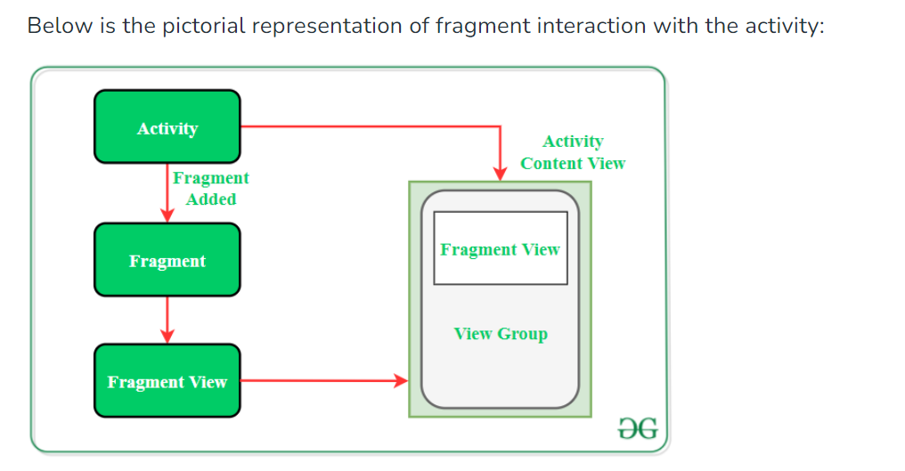
Interactions Between Fragments
Very often, an activity might contain one or more fragments working together to present a coherent UI to the user.
In this case, it is important for fragments to communicate with one another and exchange data. For example, one fragment might contain a list of items.Also, when the user taps on an item in that fragment, details about the selected item might be displayed in another fragment.

Slide 22
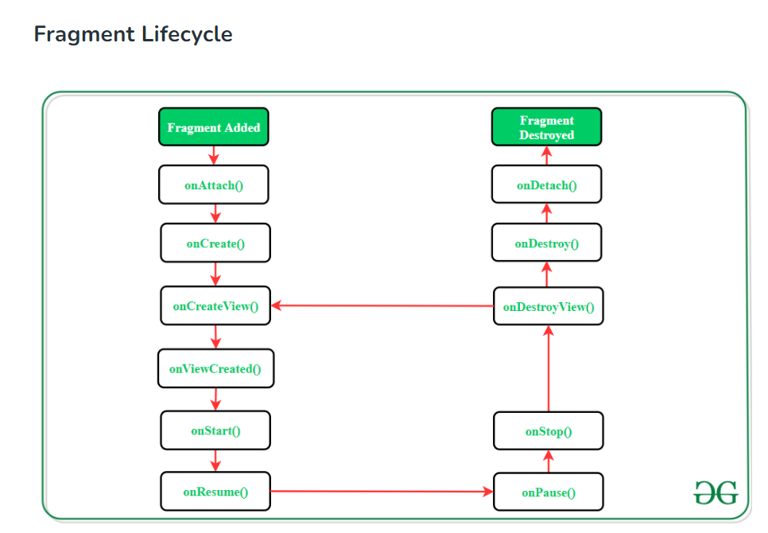

Slide 23
Fragment lifecycle
Each Fragment instance has its own lifecycle.
When a user navigates and interacts with your app, your fragments transition through various states in their lifecycle as they are added, removed, and enter or exit the screen.
Like activities, fragments have their own life cycle.
Understanding the life cycle of a fragment enables you to properly save an instance of the fragment when it is destroyed, and restore it to its previous state when it is re-created.
When a fragment is being created, it goes through the following states:
onAttach()
onCreate()
onCreateView()
onActivityCreated()

Slide 24
When the fragment becomes visible, it goes through these states:
onStart()
onResume()
When the fragment goes into the background mode, it goes through these states:
• onPause()
• onStop()
When the fragment is destroyed (when the activity in which it is currently hosted is destroyed), it goes through the following states:
• onPause()
• onStop()
• onDestroyView()
• onDestroy()
• onDetach()

Slide 25
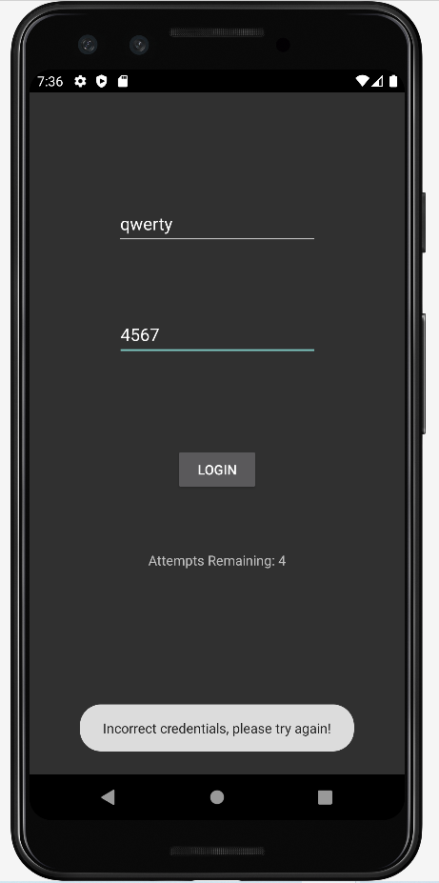
Toast
A toast is a small display on the bottom of the screen. The toast is used to display alerts to the user, it is not persistent. It flashes on the screen for a few seconds and then disappears. If it contains important information, users may easily miss it if they are not looking at the screen.

Slide 26
Android Notification
Android Notification provides short, timely information about the action happened in the application, even it is not running. The notification displays the icon, title and some amount of the content text.

